Slide 1
Dishcovery
Field Usability Test
Abena Ofosu, Sharon Wambu, Kayla Kelly, Defne Genc

Slide 2
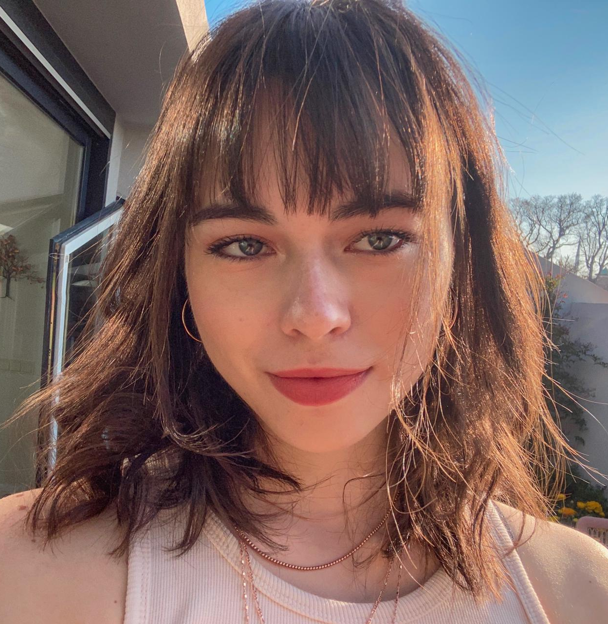
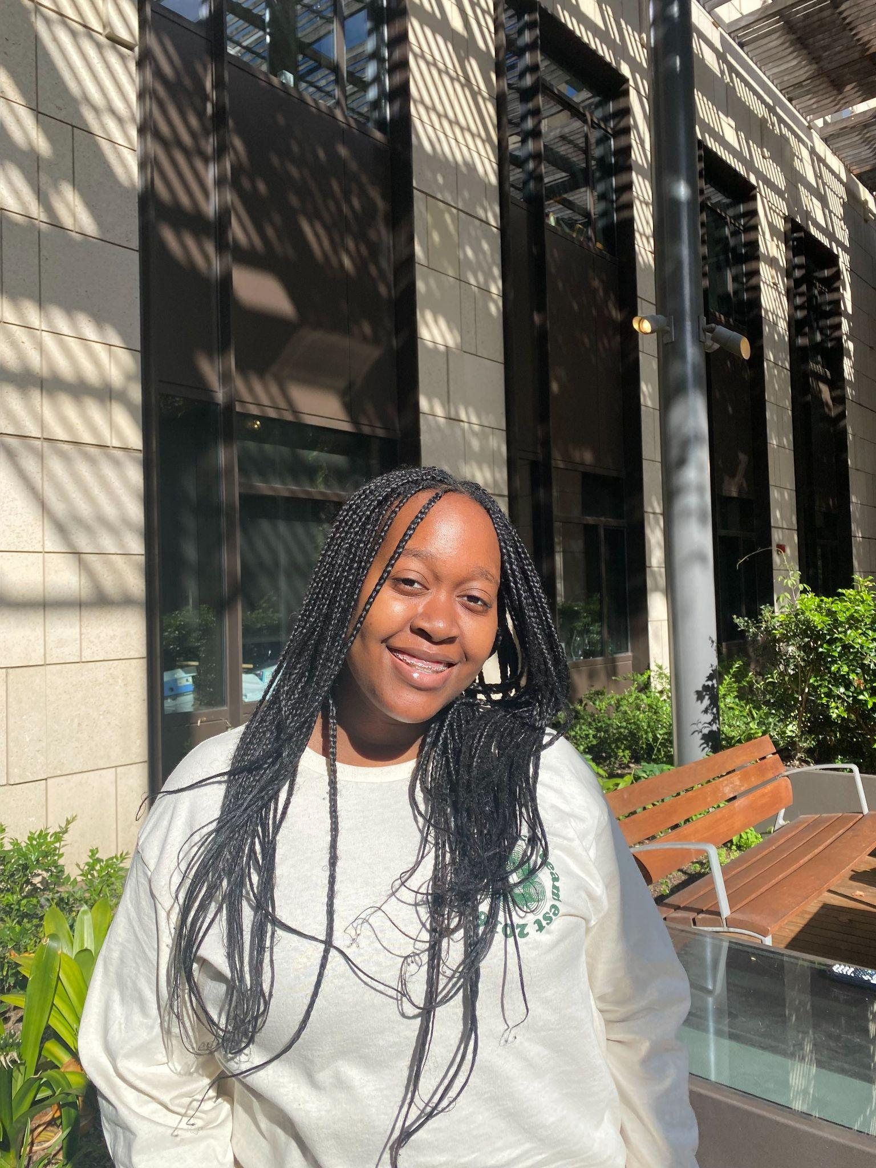
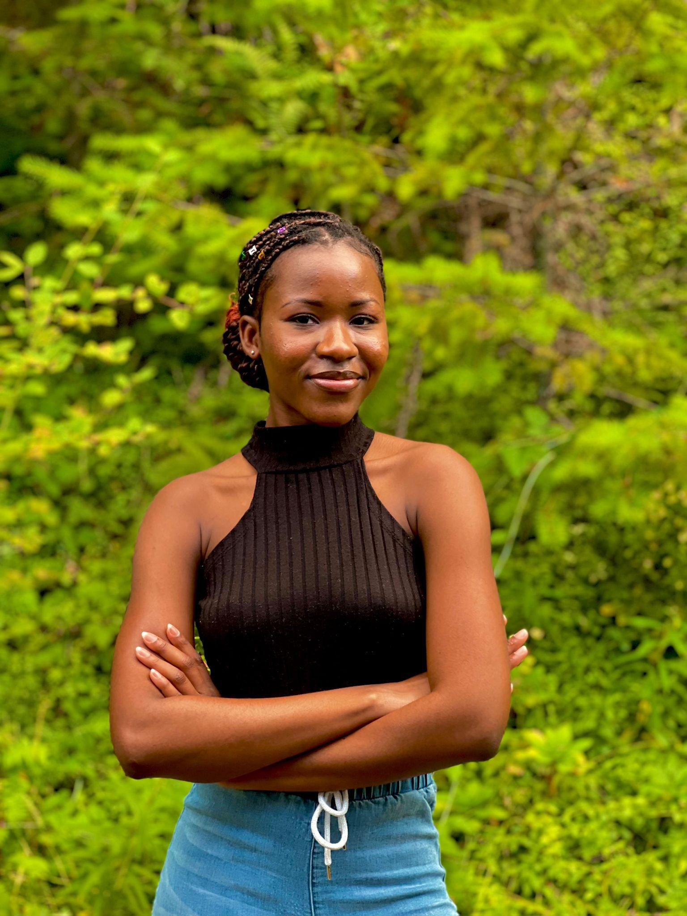
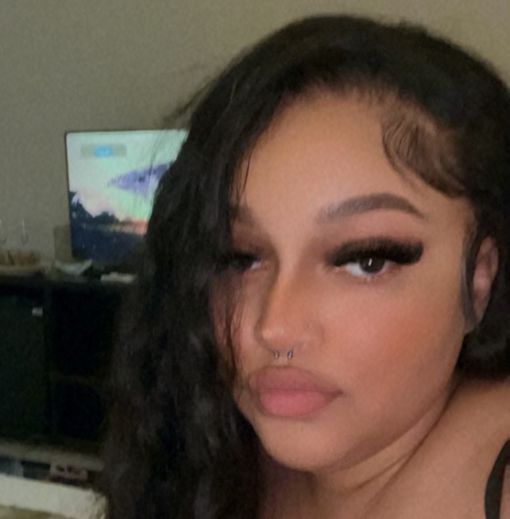
Our Dishcoverers
Defne
Sharon
Abena
Kayla
Dish of choice:
Dish of choice:
Dish of choice:
Dish of choice:

Slide 3
Presentation Outline
Introduction
01
Discussion
04
Methodology
02
Future Trajectory
05
Results
03
Purpose of experiment and evaluation
Making sense of our results.
How we conducted our tests.
What we want to improve and implement.
The data we collected.

Slide 4
01
Introduction

Slide 5
Our System
Dishcovery provided one authentic recipe, making it easier for our users to actually start cooking.
In this experiment, we evaluated the ease of performing our complex task since we were unable to measure in our lab usability.
We also measured the effectiveness of the onboarding in setting the user up to use our app.

Slide 6
Implementation changes
Onboarding
Recipe cards
Database
Making sure that users know the purpose of the app and can create an account.
Altered the look of the discard to have a shadow overlay for better readability
Made a Firebase and populated with authentic recipes that fit our new design specifications.
Notes:
Tailoring the app to the users needs

Slide 7
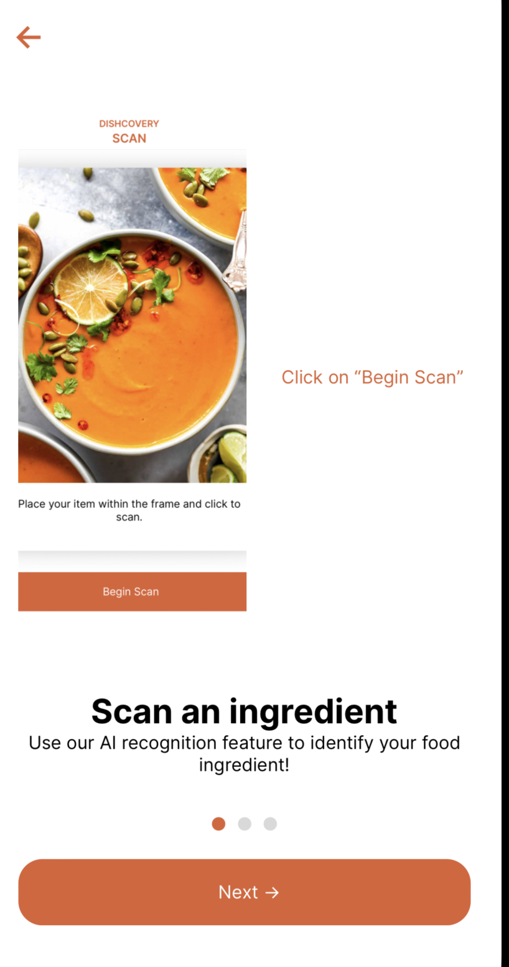
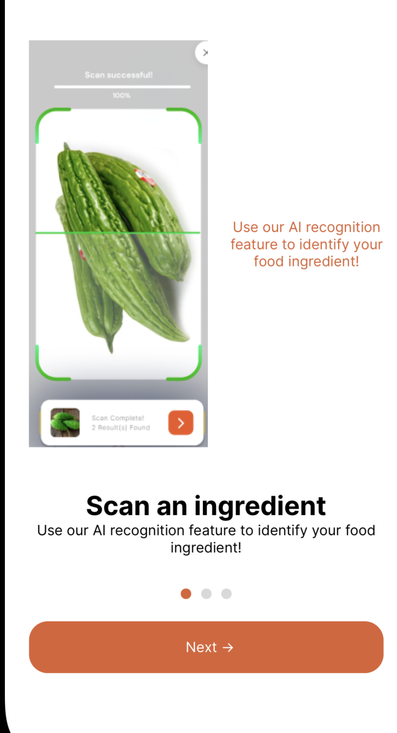
Implementation changes
Onboarding
Making sure that users know the purpose of the app and can create an account.
Notes:
Tailoring the app to the users needs

Slide 8
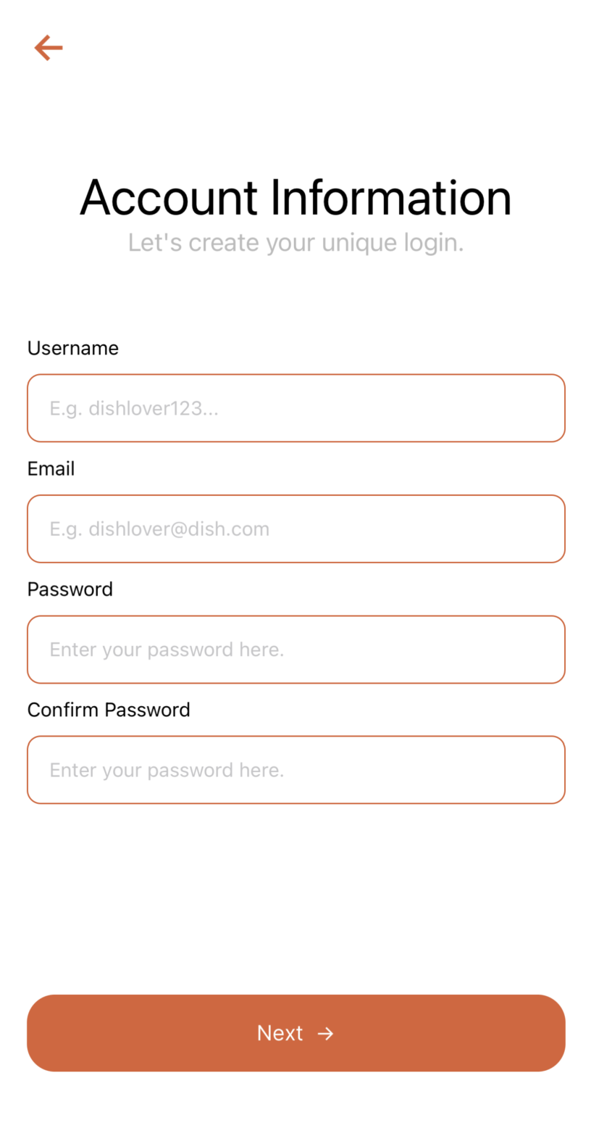
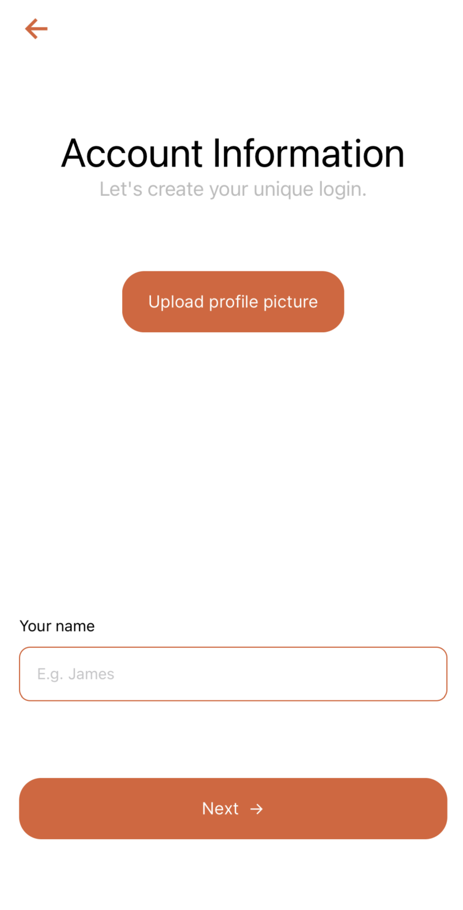
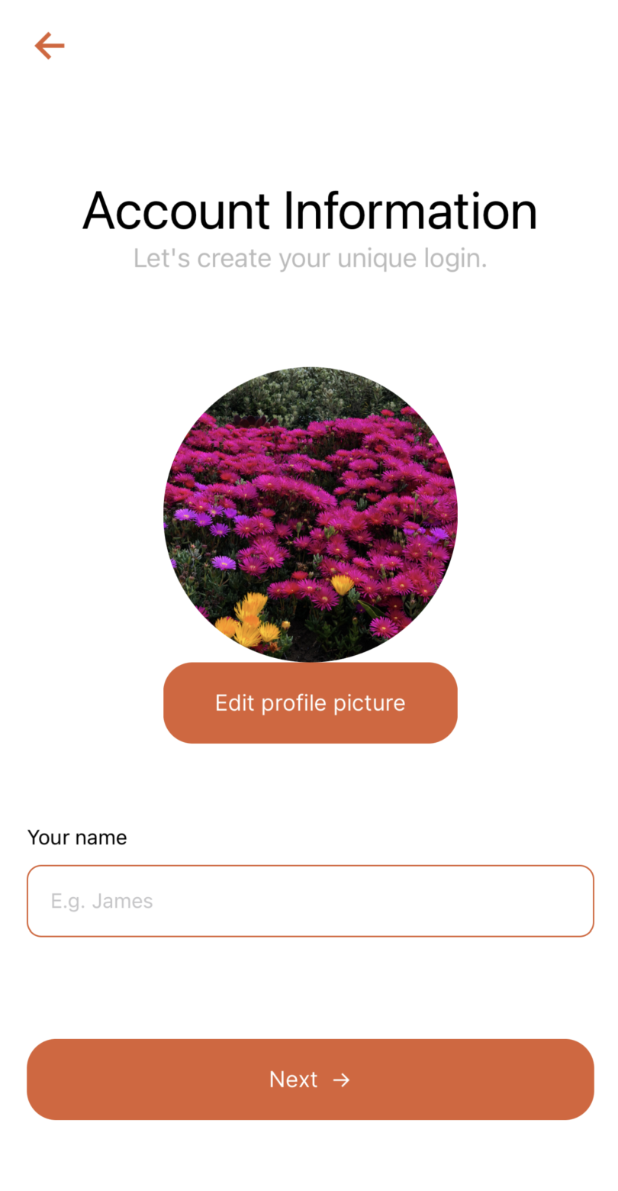
Implementation changes
Onboarding
Making sure that users know the purpose of the app and can create an account.
Notes:
Tailoring the app to the users needs

Slide 9
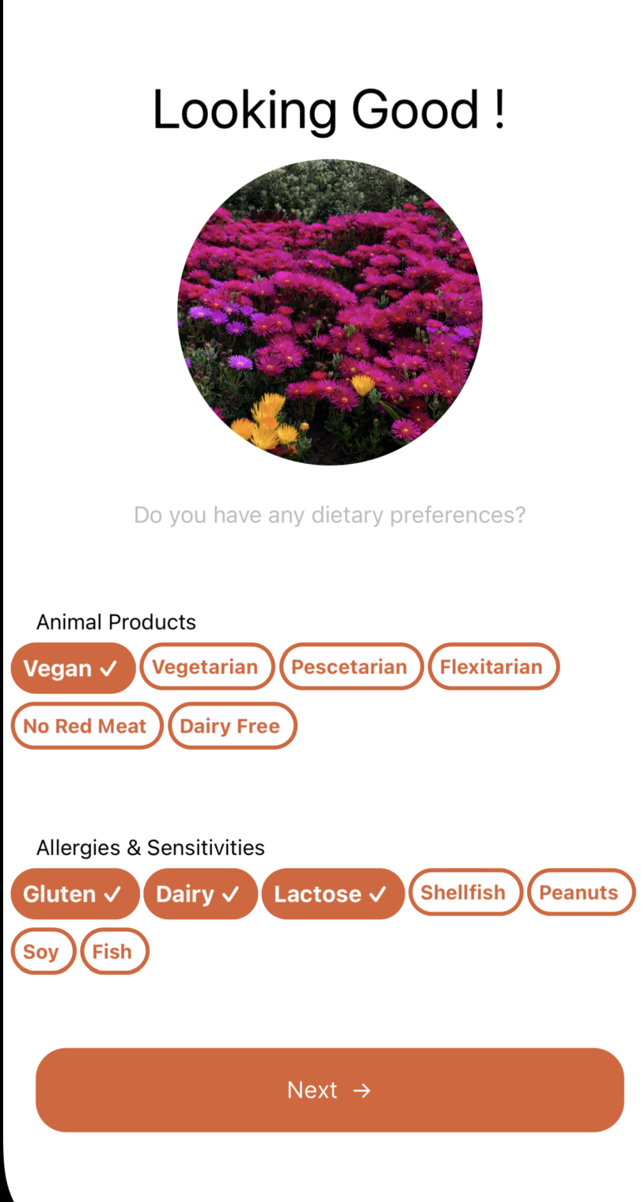
Implementation changes
Onboarding
Including clickable dietary preferences
Notes:
Tailoring the app to the users needs

Slide 10
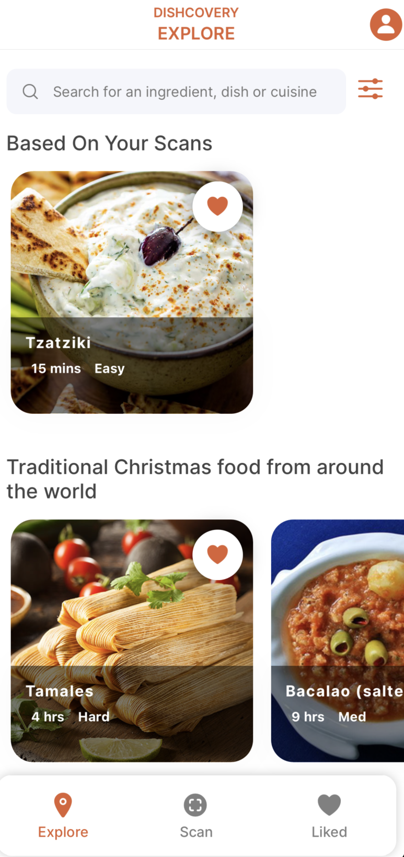
Implementation changes
Recipe cards
Altered the look of the discard to have a shadow overlay for better readability
Notes:
Tailoring the app to the users needs

Slide 11
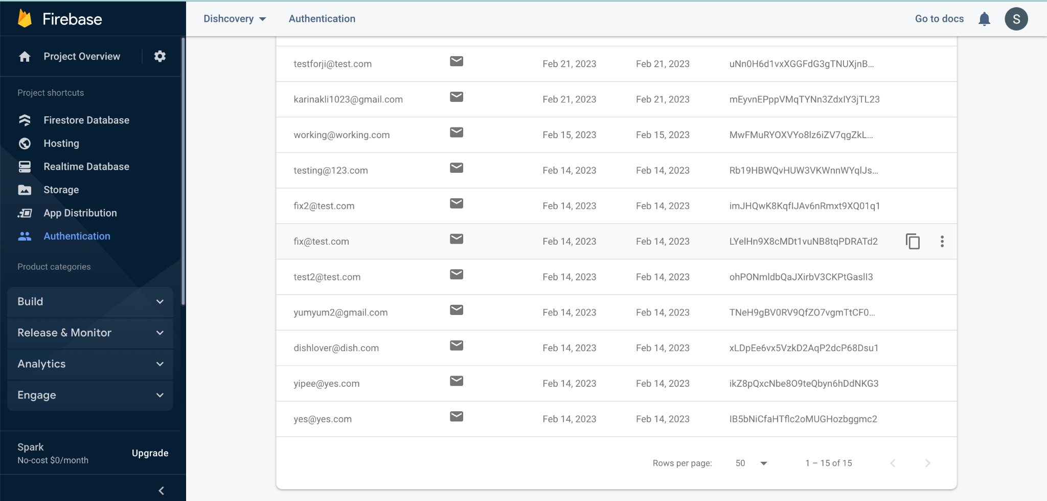
Firebase Authentication

Slide 12
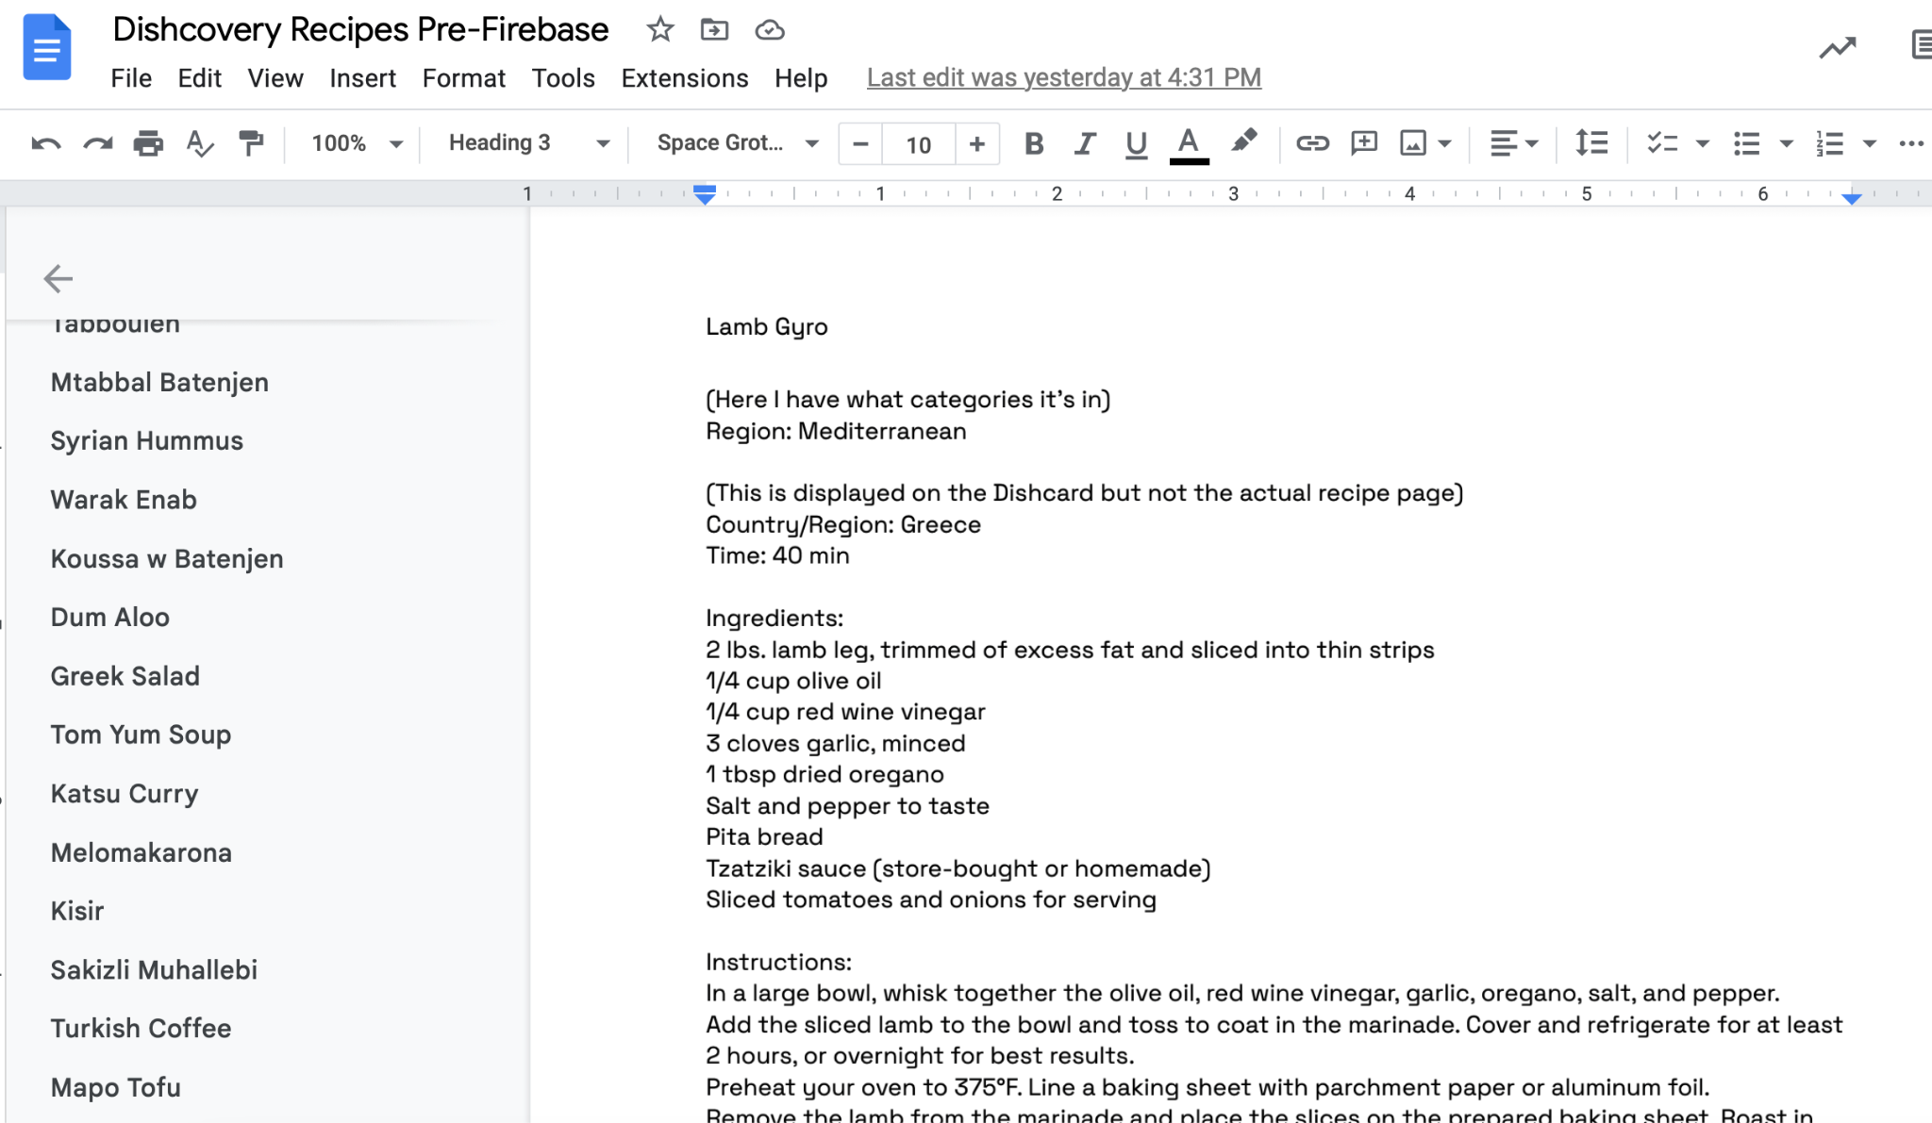
Curating recipes pre-Firebase

Slide 13
Curating recipes with Firebase
We crowdsourced authentic recipes through a Google form.
The crowdsourced recipes were added to our collections on Firebase.

Slide 14
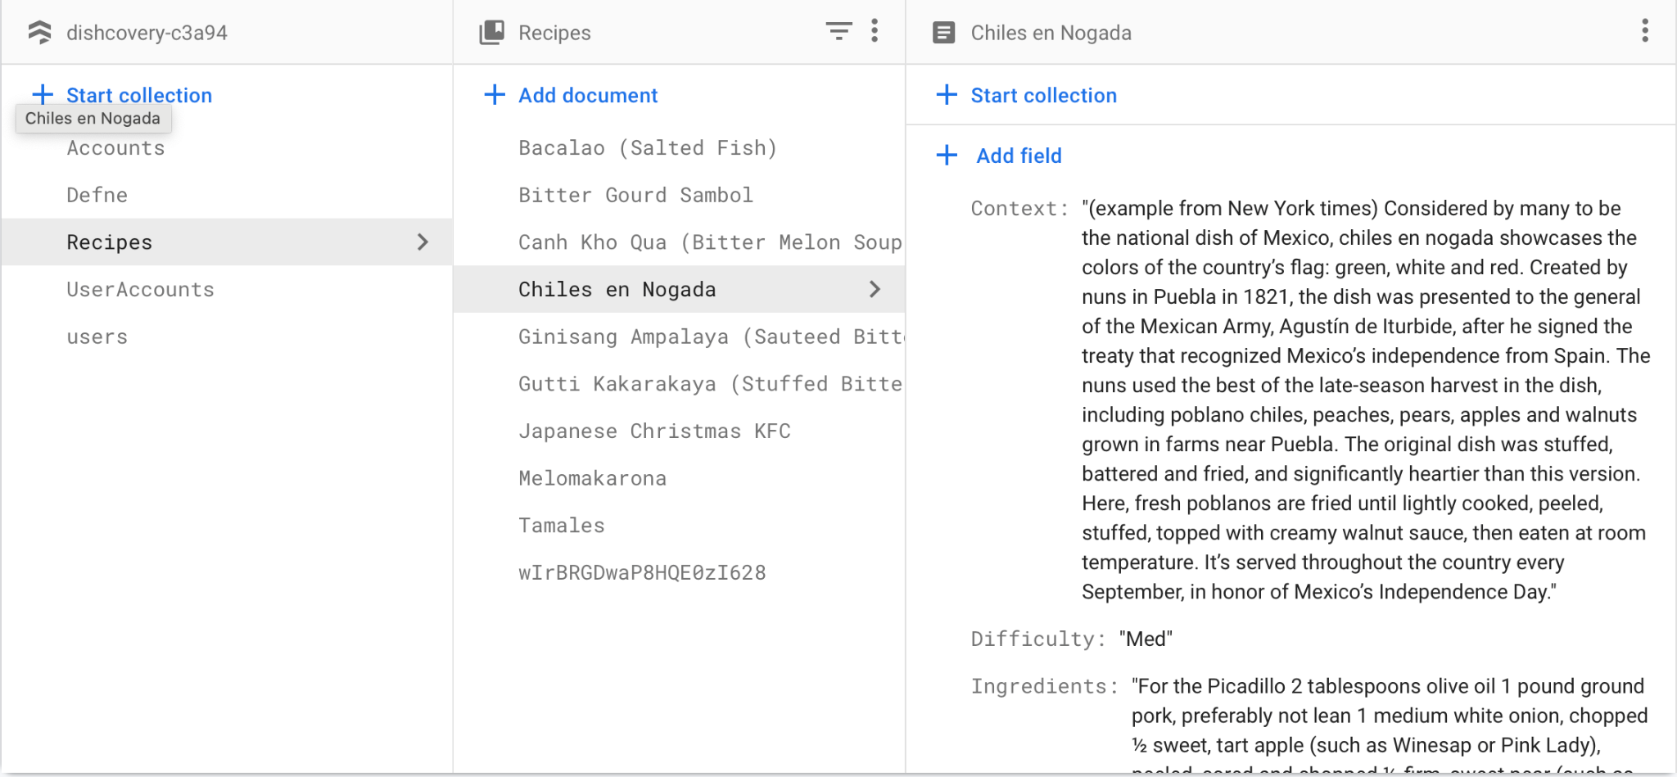

Slide 15
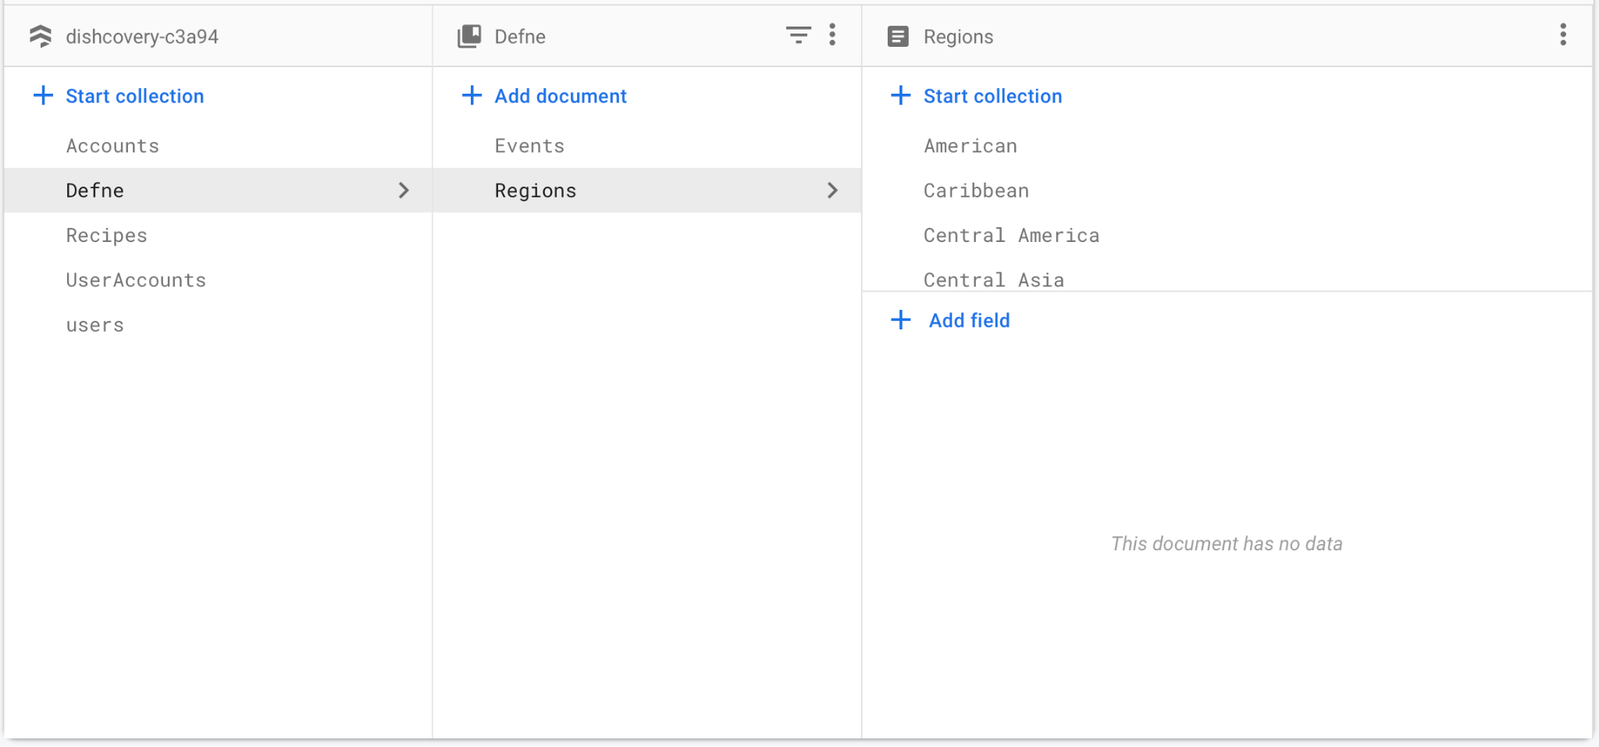
Next steps

Slide 16
02
Methodology

Slide 17
We interviewed participants who varied in…
Experience cooking food.
Cultural background.
Comfort levels with cultural cooking.
Notes:
Some who have experience and some who do not, 3 of of which are students and one who is not

Slide 18
Recruitment
Word of mouth
We made use of our social networks to recruit participants.

Slide 19
Overview of participant profiles
Undergraduate
Non-student
“Regular Joe” that mostly eats out/ uses delivery services but sometimes cooks for themselves
International student from Greece who cooks for himself in his co-op.
PhD/Instructor
Undergraduate
Who doesn’t cook often but wants to try more recipes.
Who enjoys cultural cooking.
A Pittsburgh local, Caitlin cooks for herself every day in EVGR-B.

Slide 20
Testing methods.
Cooking test in the field
All of our participants had the chance to cook using Dishcovery!
Notes:
We had participant who were not cooking simulate an environment in which they would after interacting with the ui. Having them in their homes made the experience more comfortable for them

Slide 21
Testing method.
We used a single recipe and the same onboarding process, introducing more uniformity to this testing process.
We had participants go through the onboarding process before cooking using the recipe on the explore page.
We had all participants prepare tzatziki, a dish so common and popular in Greece that Greeks describe it as “their ketchup”.
Notes:
We had participant who were not cooking simulate an environment in which they would after interacting with the ui. Having them in their homes made the experience more comfortable for them

Slide 22

Methods of compensation
Food/Ingredients
Gift cards.
Providing ingredients for them to cook with.
To incentivise those who wouldn’t be as encouraged with only ingredients.
Notes:
To allow have more resources for the field usability which would entail a lot more

Slide 23
Recap of our Task Flows
1
Search
For an unfamiliar food item through scanning.
2
Contextualise
Using the information provided in the app.
3
Authentic Cooking
Through recipes the user finds and/or saves.
Notes:
Scan, learn about the ingredients, and cook with your newfound knowledge

Slide 24
Focus of this experiment
Since we’re doing a field test and previously focused on the scanning aspect, in this test, we mainly focused on:
Task 3: Culturally authentic cooking
Viewing recipe
Going back and forth between context, ingredients, and instructions
Finding the recipe from the explore page.
New task flow! Onboarding
Choosing dietary preferences
Creating an account
Uploading a profile picture
Viewing the app tutorial

Slide 25
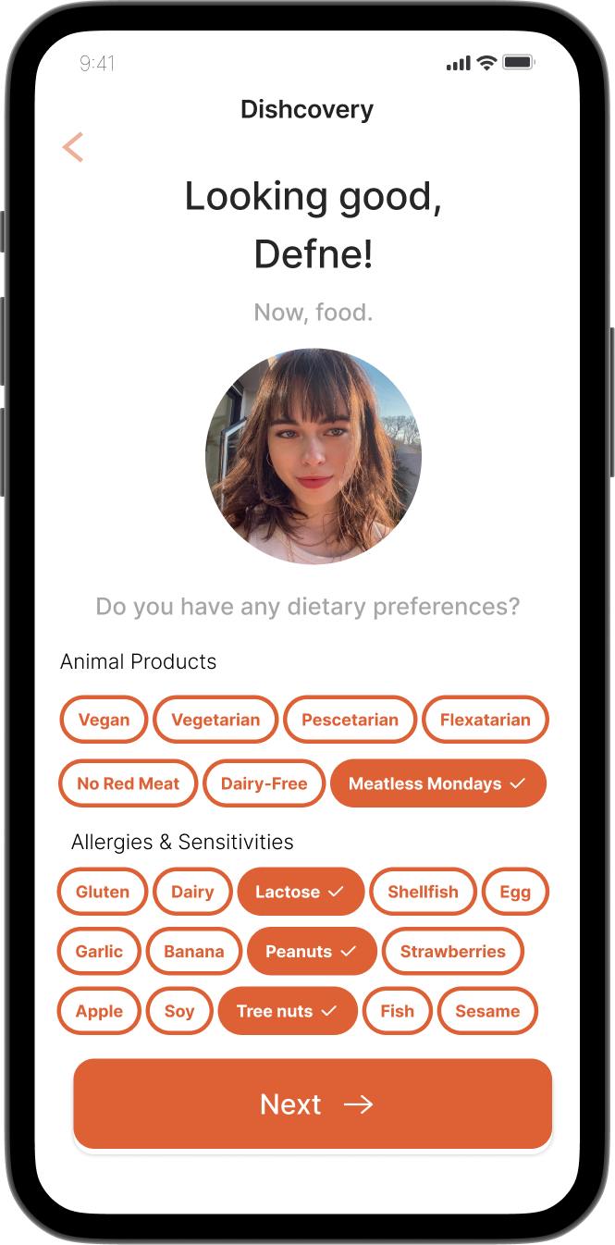
Onboarding
We were looking to learn:
Is the onboarding process intuitive?
Are users confused by any of the information asked of them?
Do they interact with the UI easily and complete onboarding quickly?
We measured:
How long onboarding took from start to finish.
# of questions or mistakes

Slide 26
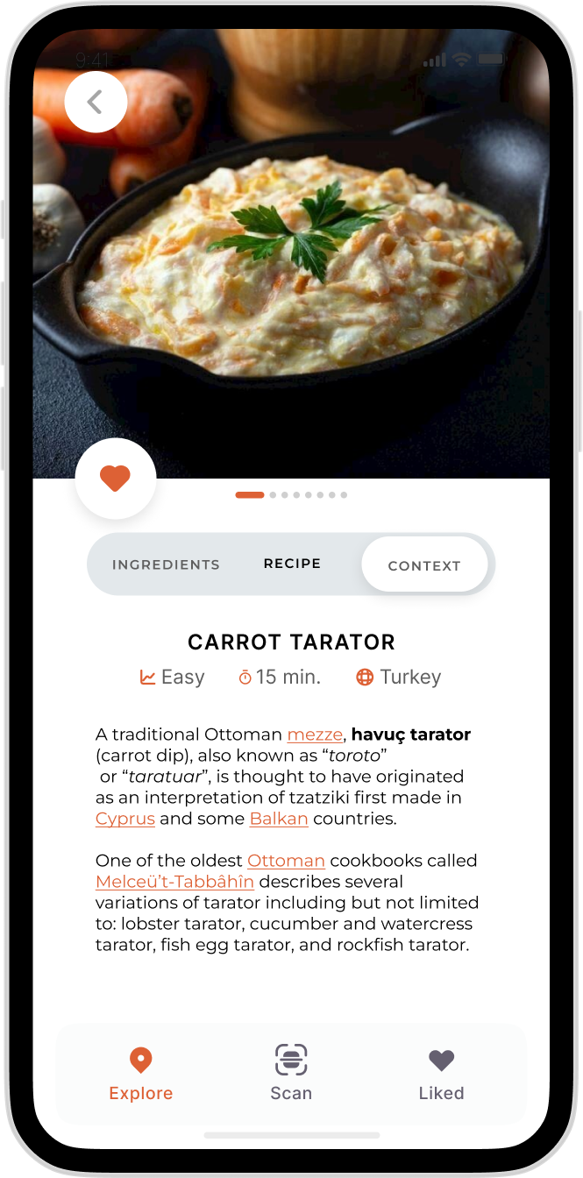
Cooking using the app.
We were looking to learn:
What part of the cooking process is difficult or intuitive?
Do users have trouble navigating the recipe pages?
Do they seem curious about the information presented to them?
We measured:
How long the task of reading through the recipe took.
How many times they made mistakes in the process.
% match between stated recipe time and how long it took them to prepare
Notes:
For those who were not able to cook(2), for those who were(1)

Slide 27
Procedure
Have users complete their onboarding.
When on the recipe screen of the app, ask them:
Based on your initial reactions, what do you think you’re able to do on with the recipe?
Time how long each task took as well as how many mistakes participants made, and in which task.
Ask our questions and allow them to ask us more about the app.
E.g. what information did you enjoy seeing? What else would you like to see?
Notes:
Asked them what their initial impressions were, made them perform the tasks, measured what we were looking for and then asked them questions after

Slide 28
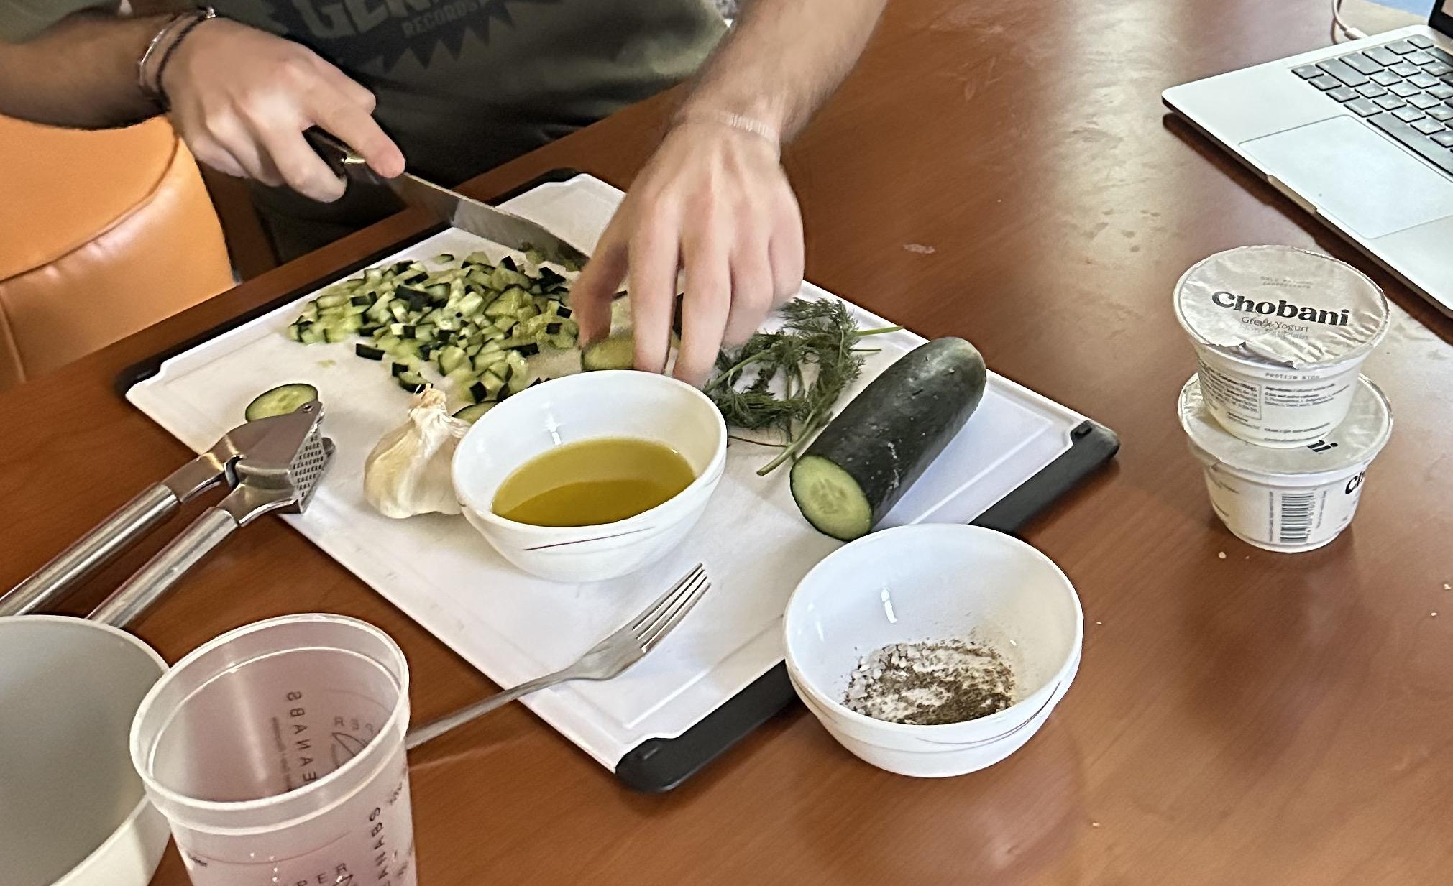
Materials & Apparatus
Tzatziki ingredients: cucumber, garlic, olive oil, red wine vinegar, dill, salt, pepper, Greek yoghurt.
Cooking utensils.
VSCode for implementation updates.
iPhone timer to measure the length of each task.
Otter.ai(for transcription) and Apple VoiceNotes
Firebase for populating the backend.
Expo Go.

Slide 29
Location
Residence of participants
The Dishcovery team traveled to each participant’s place of residence for the study.

Slide 30
Cooking test with Terrence.
A working class man who doesn’t like to cook for himself unless he is tired of/burned out with the local options.
Terrence wants to cook more at home to save money but only knows basic recipes which leads to him ordering out.

Slide 31
About Terrence
24 years old
Lives alone, where he cooks for himself periodically
Rates his cooking skills a 6/10
“Average home cook, but rarely tries new things.”

Slide 32
Cooking test with Caitlin.
Works at the Stanford Philosophy Dept & GSE, enjoys cooking herself comfort meals.
Caitlin cares a lot about uniting friends and family through cooking, and prides herself on her vegetarian chili.

Slide 33
About Caitlin
30 years old
Works in the Philosophy department and the Graduate School of Education.
Lives in EVGR-B, where she cooks for herself in her studio.
Rates her cooking skills a 7.5/10
“Above average home cook, but I struggle to try new things.”

Slide 34
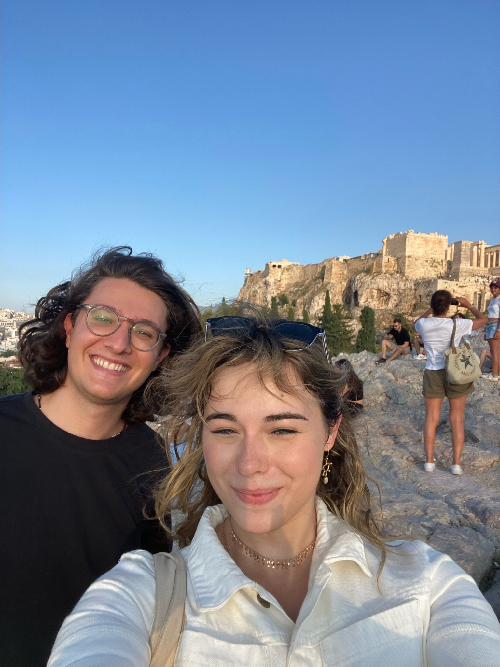
Cooking test with Constantinos.
Testing a Greek recipe on a real Athenian.
*We want to advertise Dishcovery’s authenticity, so Constantinos’ advice and feedback on our Greek recipe will become very valuable.

Slide 35
Acropolis
Me
Constantinos

Slide 36
About Constantinos
Greek, grew up in Athens
Cooks for himself weekly now, used to cook for himself every day during the pandemic.
Relatively confident in his cooking skills, rates himself a 6/10.
Loves Greek food.
Says that since some Greek food is originally Ottoman/Turkish/Arab/Balkan, he likes learning about how they do it differently elsewhere.

Slide 37
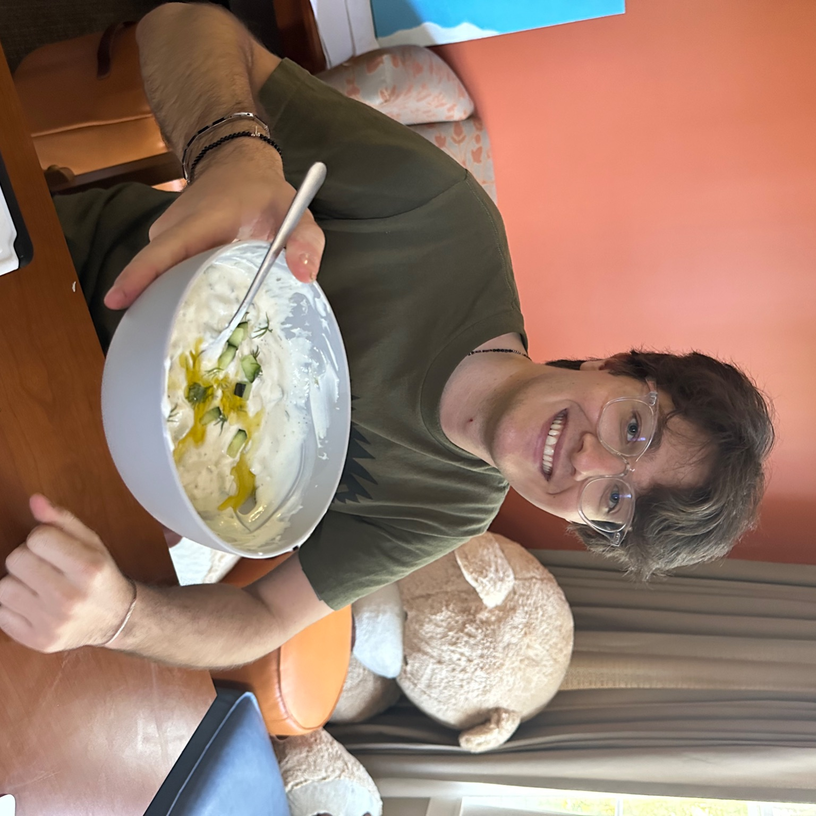
—Constantinos Gallis
“ I can’t overstate the importance of this dish and how common it is everywhere— it’s rare to go somewhere in Greece and not be able to find it. I’d like to see even more done to emphasise this on the app somehow.”

Slide 38
About Clinton
Cooks monthly; weekly during the breaks
Very confident in his cooking skills, rates himself a 15/10.
Loves familiar food.
Says that familiarity is important - having a set recipe took that away but then having an ingredient to scan narrows down the choice.

Slide 39
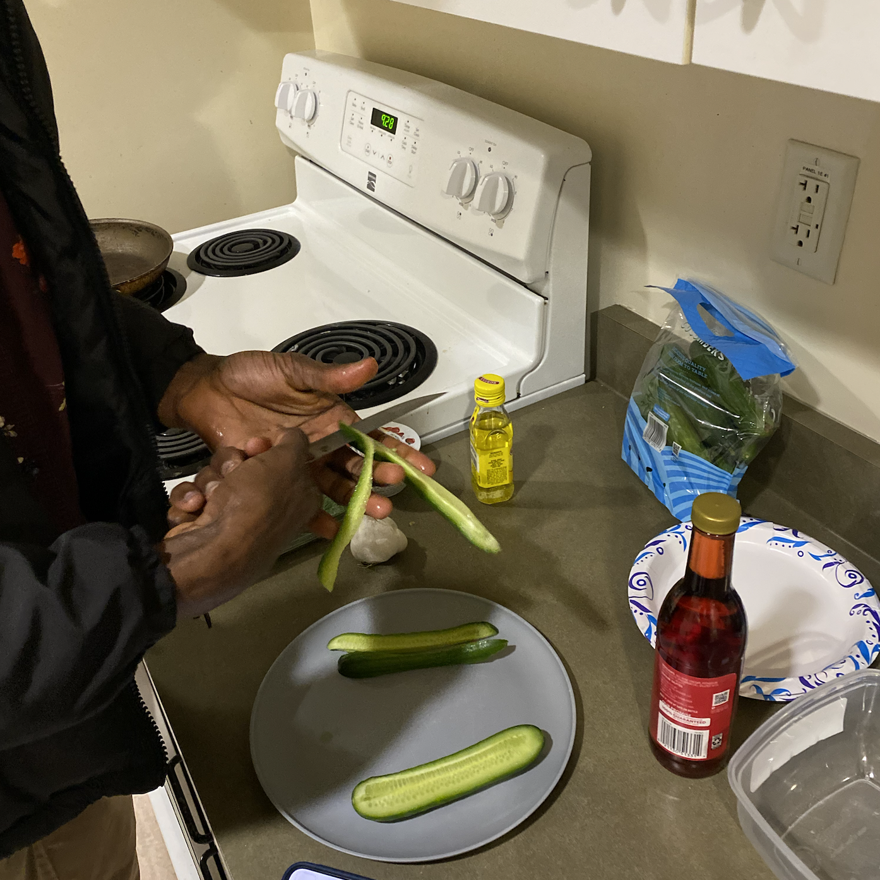
—Clinton Kwarteng
“I would not want to try a random dish I know nothing about.”

Slide 40
About Justin
Doesn’t cook on campus, but helps with cooking at home, especially for special occasions
Not very confident in his cooking skills, rates himself at a 4
Finds it easier to cook with a set of instructions to follow
Wants to cook more often

Slide 41
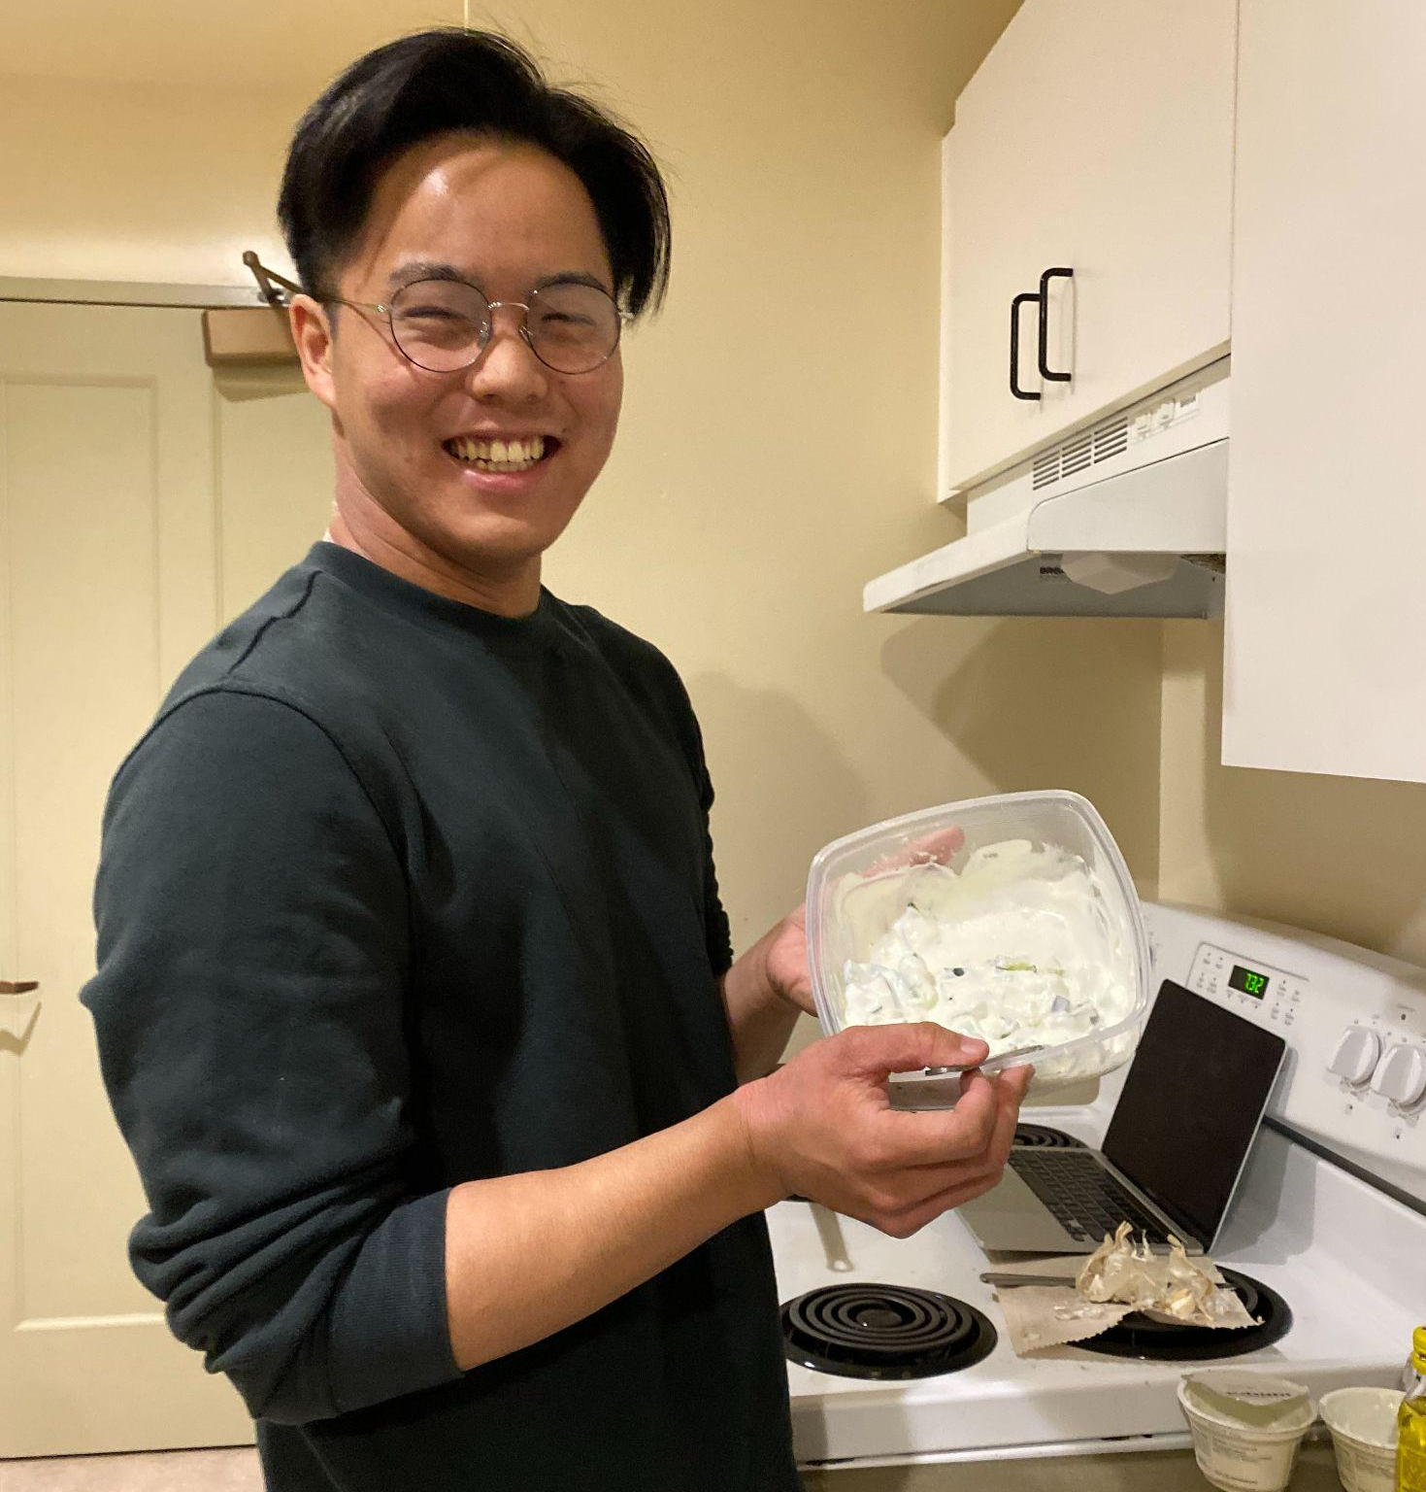
—Justin Lim
“I just haven’t cooked very much. If I do, it’s something really simple like mashed potatoes. But I’d like to cook more, especially because of all the cooking videos I see on social media.

Slide 42
About Bless
Undergrad, worked at a sushi restaurant in Germany for almost a year
Freshman - lives in Florence Moore
Cooking rating = 10/10 if he is familiar with the recipe ; 4/10 if not
Cooks once a week, loves something simple.

Slide 43
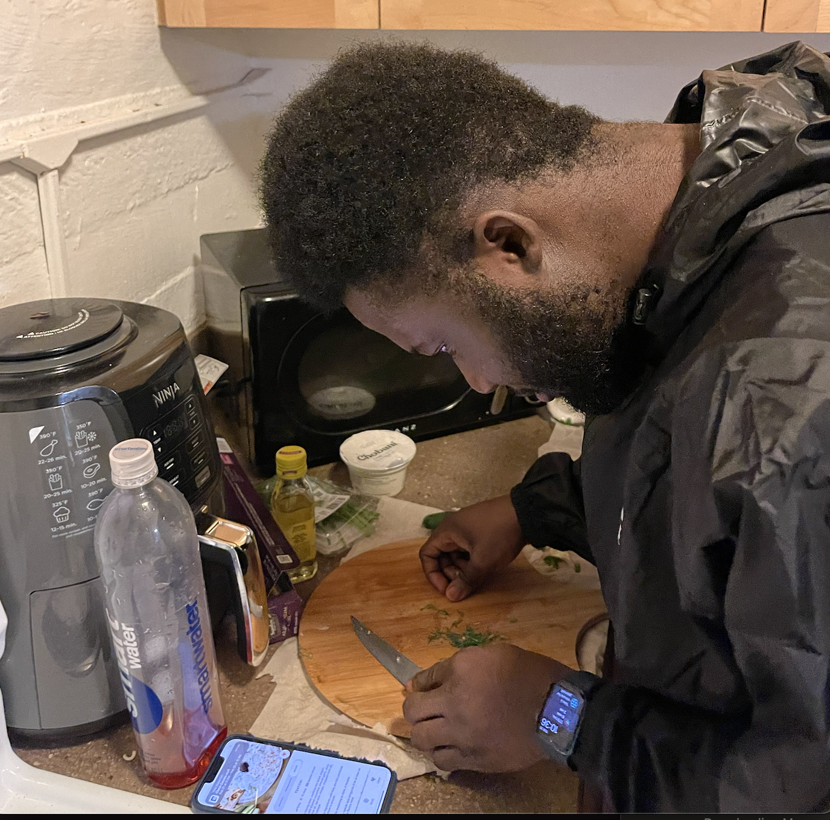
—Bless Mensah
“I feel like giving credit to the origins of the dish is very important. Although not Greek, I appreciate that this is a part of your app.”

Slide 44
Ending questions
What did you think about the use of visuals? What would you have liked more or less of?
What about the interface made cooking easier? What made it harder?
Which part made you most excited about this dish?
What other questions do you have about the ingredient or the dish?
What other questions do you have about the app?

Slide 45
03
Results

Slide 46
Quantitative data we measured
How long did each task take?
How many times did they navigate to an incorrect page when looking for something else?
How many seconds, on average, do they spend looking for a page?
How long did they take to view context?
Notes:
Time taken to complete tasks, hesitations and errors made in navigating pages

Slide 47
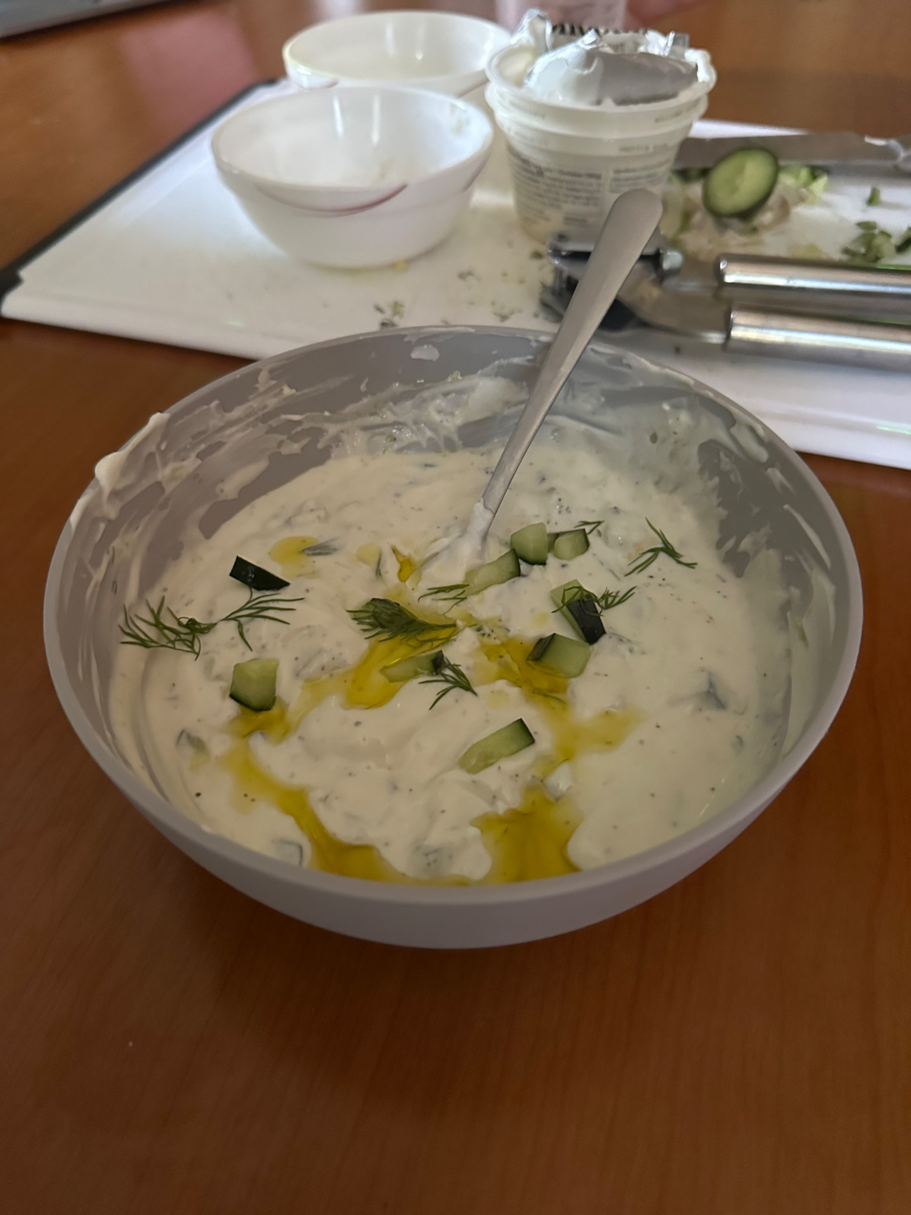
Summary - Constantinos
# of errors or questions:
0 errors
1 question during onboarding regarding allergies
Time taken for each task:
- Onboarding: 2 minutes 5s
- Cooking: 15 minutes 1s
- Reading context post-cooking: 1min 21s
- Said he really liked learning about the variations,
said “I didn’t know that” for a lot of it.
Was satisfied with the recipe.

Slide 48
Summary - Caitlin
# of errors: 1, couldn’t read instructions
Time taken for each task:
- Onboarding: 3min
- Cooking: 13min 22s
- Recommendations:
- Featuring complementary dishes
- Highlighting context before cooking.

Slide 49
Summary - Terrence
# of errors: 1, simple typos
Time taken for each task:
Onboarding: 2min 12s
Cooking: 22min 16s
Reading context pre-cooking: 2min 27s
Feedback
Text alignment not consistent
Nice interface
Might be fun to have recommendations based on previous dishes & also even just recommendations by ingredient instead of full meals

Slide 50
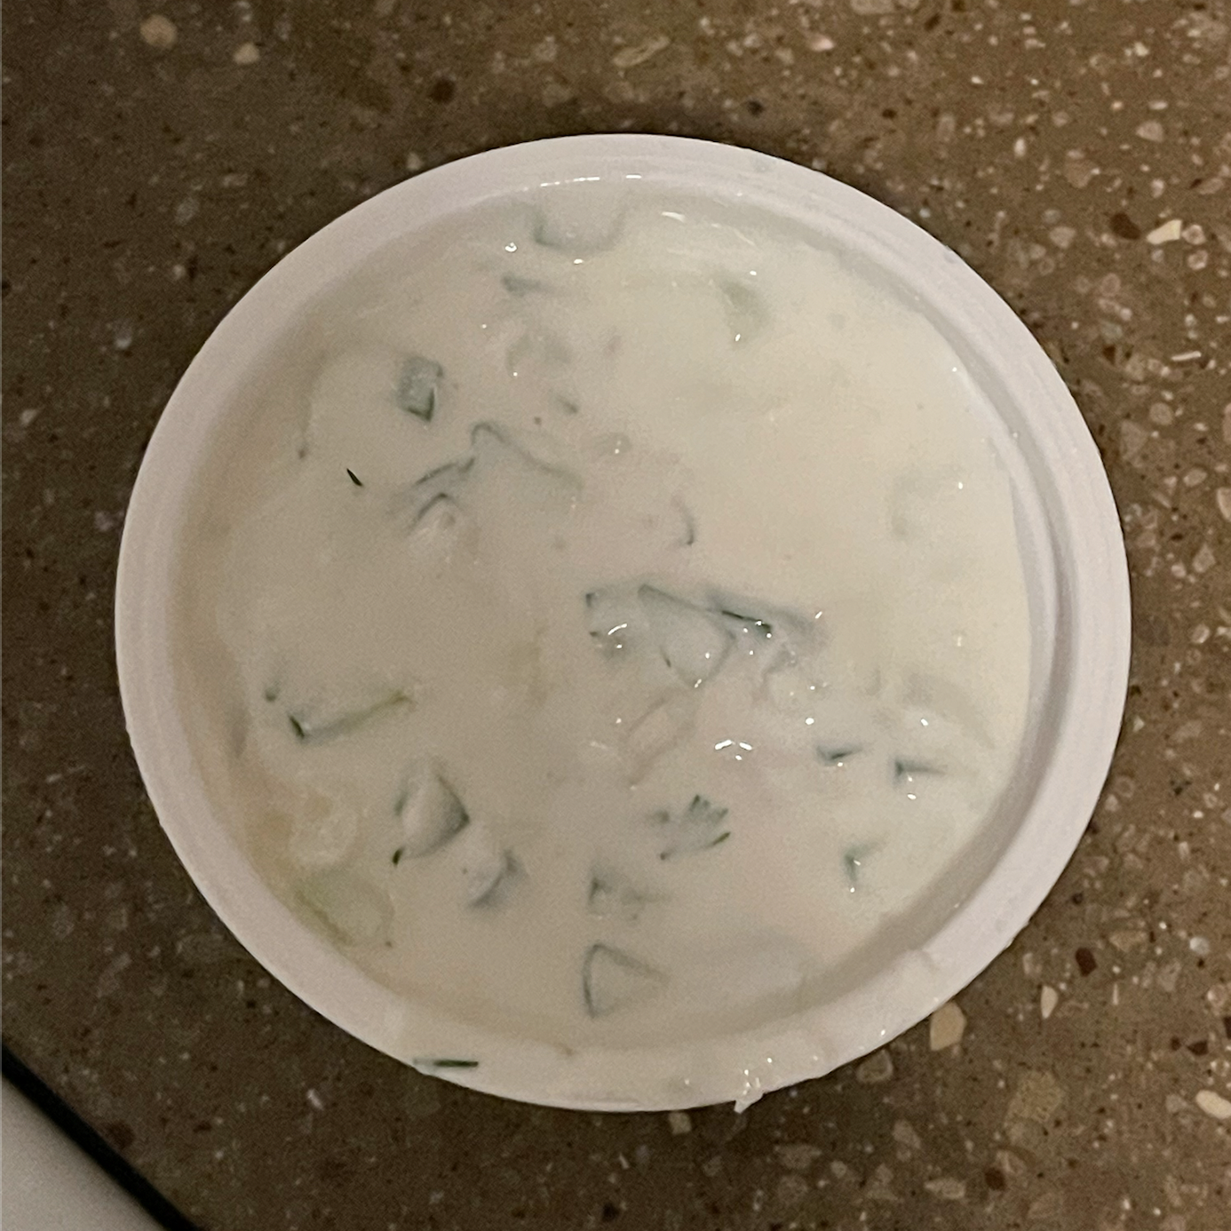
Summary - Bless
# of errors or questions:
2
Password entry confusion
Mistook like button on recipe for a review metric.
Time taken for each task:
- Onboarding: 1 minutes 23s
- Cooking: 16 minutes 34s (very meticulous)
- Reading context pre-cooking: 36s
- Feedback
- User-friendly. Simple enough, but not drab
- Missing recipe quantity for some of the ingredients
- Had to navigate back to verify quantity

Slide 51
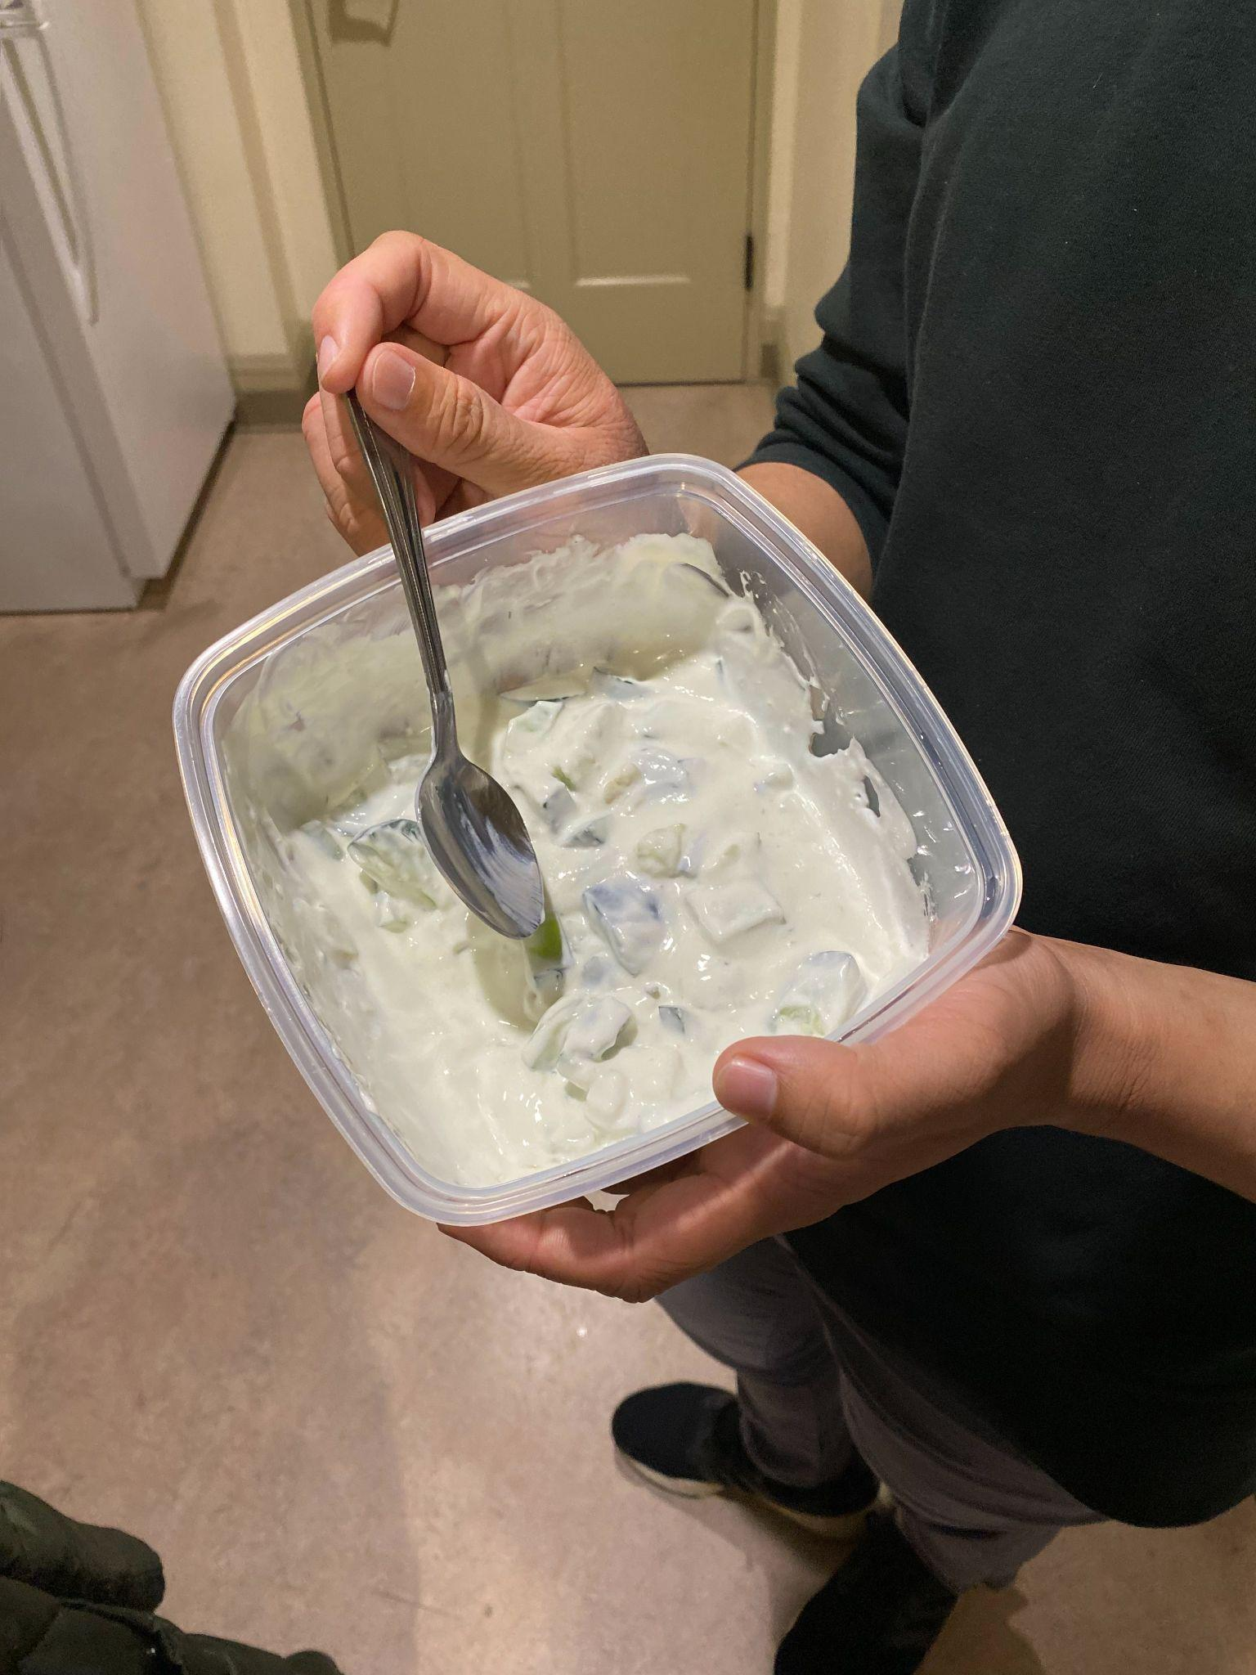
Summary - Justin
# of errors or questions:
1 : Password entry confusion (view blocked by keyboard)
Time taken for each task:
- Onboarding: 2 minutes 46 s
- Cooking: 12 minutes 22s
- Reading context cooking: 57s
- Feedback
‘very cute’ interface; instructions are easy to read
keyboard view shifting
blocking dietary restrictions
Being able to scroll here might be helpful

Slide 52
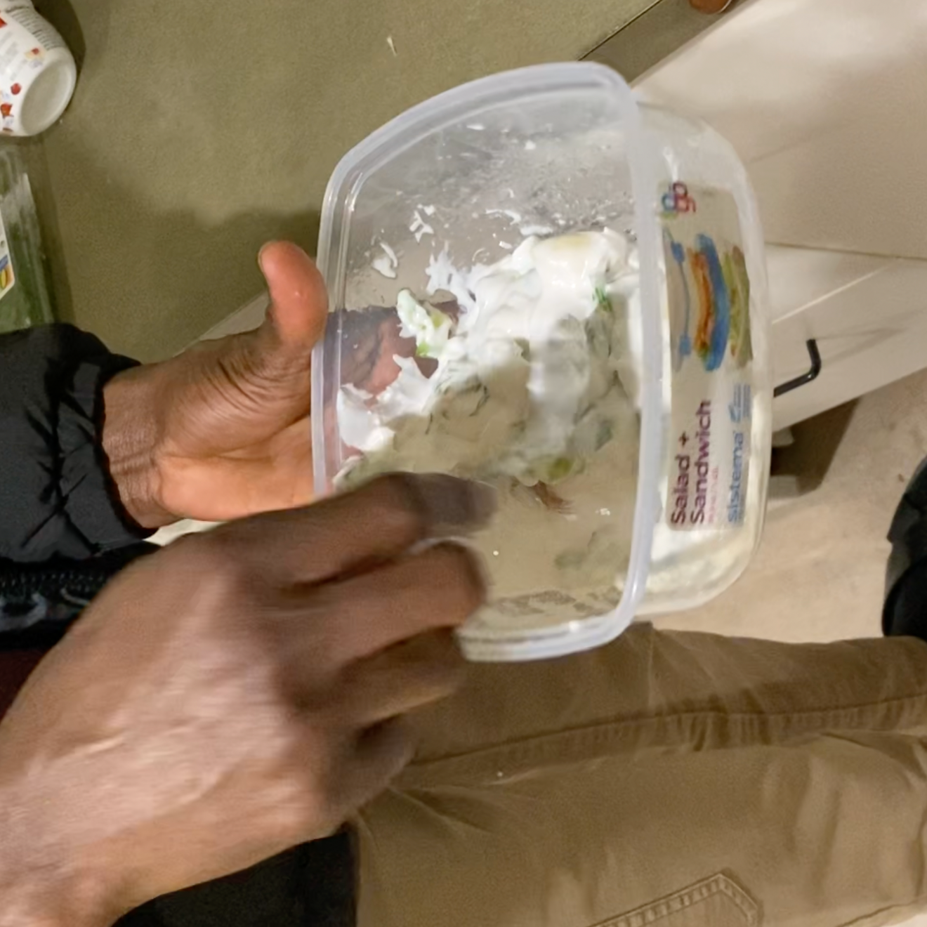
Summary - Clinton
# of errors or questions:
1 : Password entry confusion
Time taken for each task:
- Onboarding: 1 minutes 32s
- Cooking: 6 minutes 47s
- Reading context pre-cooking: 19s
- Feedback
- thought that the recipe picture was unrealistic.
- full page recipe was easier to navigate especially when his hands were occupied

Slide 53
04
Discussion

Slide 54
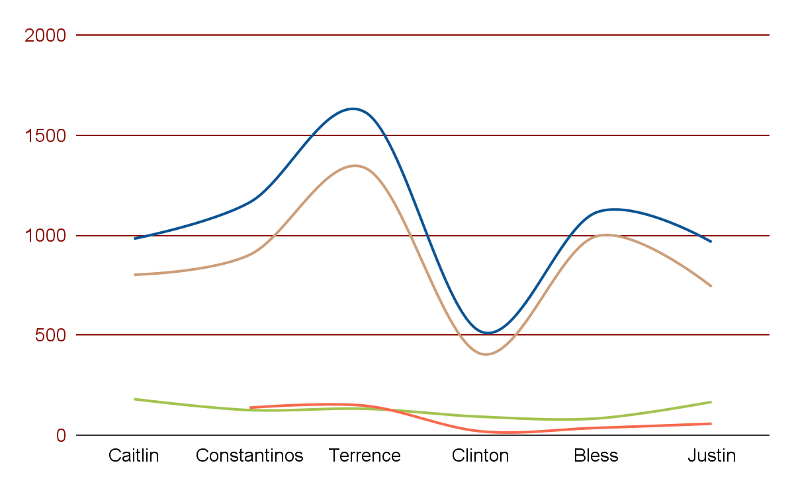
Task time graph
Onboarding
Average total time = 2 min 9s
Errors = 2
Context
Average total time = 79.2 s(out of 5)
Errors = 0
Cooking
Average cooking time = 14 mins 27 s
Errors = 0
Total time
Average total time = 31 mins 33 s

Slide 55
Percentage completion of task 3
100%
Of participants cooked the dish successfully!

Slide 56
Takeaways from Pilot run
Onboarding flow
Ingredient quantity
Users found the onboarding very informative but had issues with the password entry
One participant had to estimate vinegar quantity. Might be harder for a total beginner if portion is absent in recipe.
Cultural Contexts
Recipe steps
Users were interested in knowing about any special holidays a dish might be prepared for / common other dishes that are paired with it
Arrangement of content makes it easier to follow than a recipe website.
Notes:
Most of our participants were interested in trying a new recipe and learning about the dishes in their cultural context

Slide 57
Interface Changes for Experiment
Users had trouble with the keyboard blocking the view for the Account Information screen
Dietary restrictions spill into the next view when a user selects too many - to be resolved in onboarding
Users weren’t always interested in seeing the context until after cooking. We are evaluating where this information should be placed.
The “like” button caused some confusion, with users not being sure whether it was a review.

Slide 58
Interface Changes based on results
Some Users expressed an interest in seeing videos or pictures of steps along the way. We will consider this
Toggling between options for card-based recipe viewing (explained further in later slides) vs list based recipe viewing
Adjust placement of “Strong Password” recommendation for more User Control (sometimes blocked the textbox

Slide 59
Running the experiment in intended setting
Found that users had to improvise without certain tools or knowledge of cooking techniques (ex. Dicing instead or grating)
Practical tips may help the user not get stuck on a step
Clickstream logging will be used in our next test

Slide 60
05
Future Trajectory

Slide 61
Suggestions from participants
Onboarding
Tutorial images could be more descriptive.
Image preview instead of using a button.
For name field: Name or Full Name?
Recipe page
Align text with itself and make numbers bigger in instructions.
Have some indicator for when a dish has a “National Dish” level of importance.

Slide 62
Design &
Content Changes

Slide 63
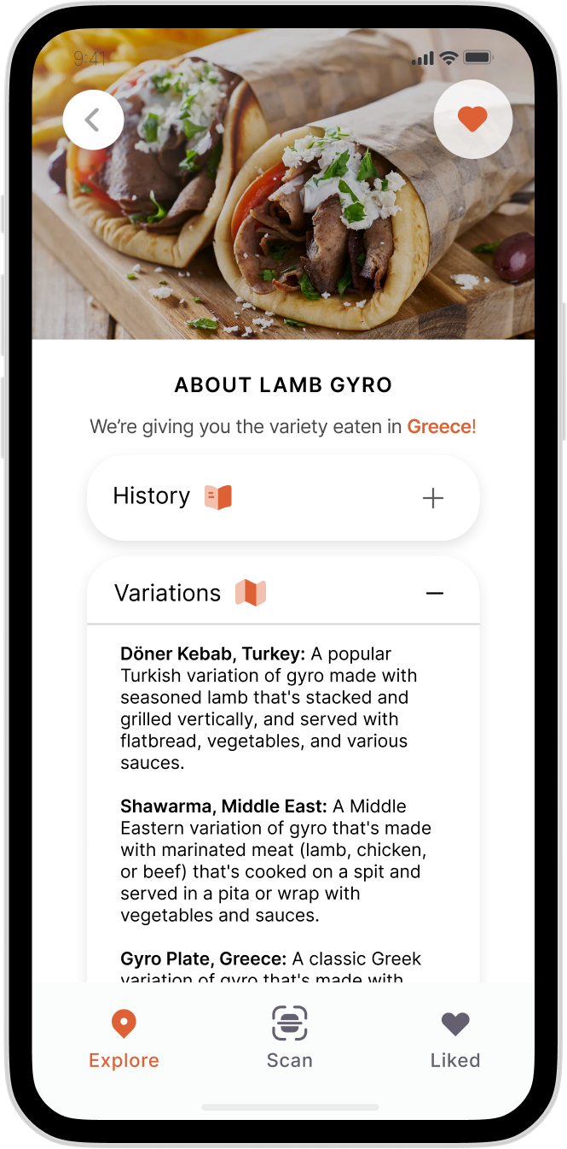
Recipe Presentation
For the future, we’ve decided to state one variety of a dish, then offer alternatives should users choose to research them separately.
Our main priority will be to have an overall uniform representation of different cultures.
I.e. if we opt for the Lebanese variety of Tabbouleh, we’ll maybe present the Palestinian or Syrian variety for Shawarma

Slide 64
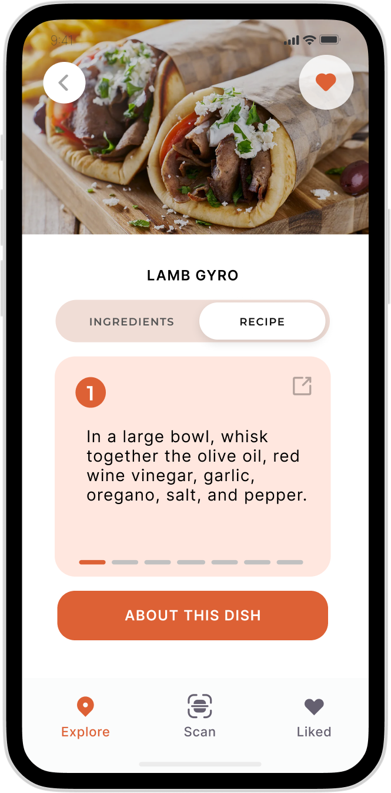
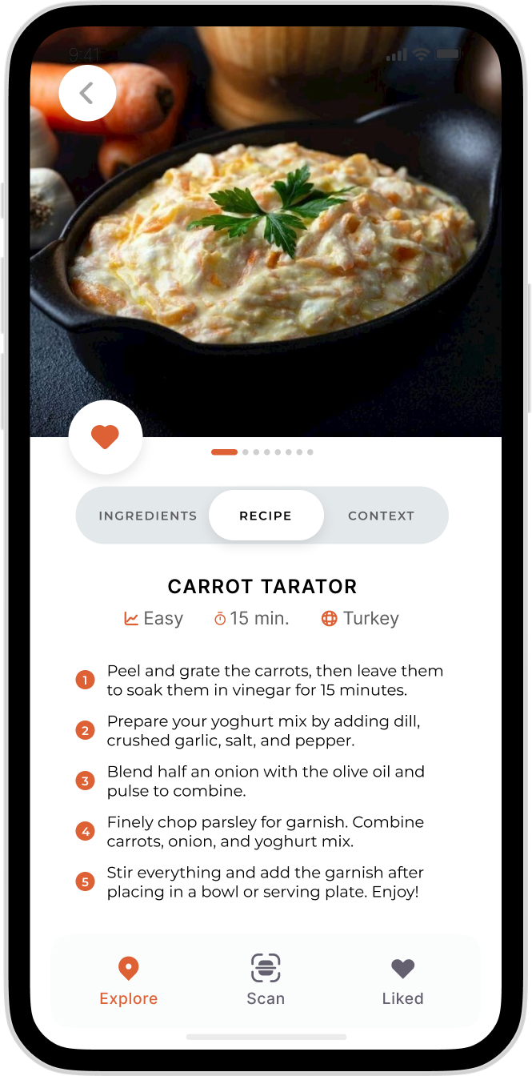
Before
Instructions
After

Slide 65
Before
After
Image takes up less space
Added muted orange
Context centralised
Story-style recipe navigation

Slide 66
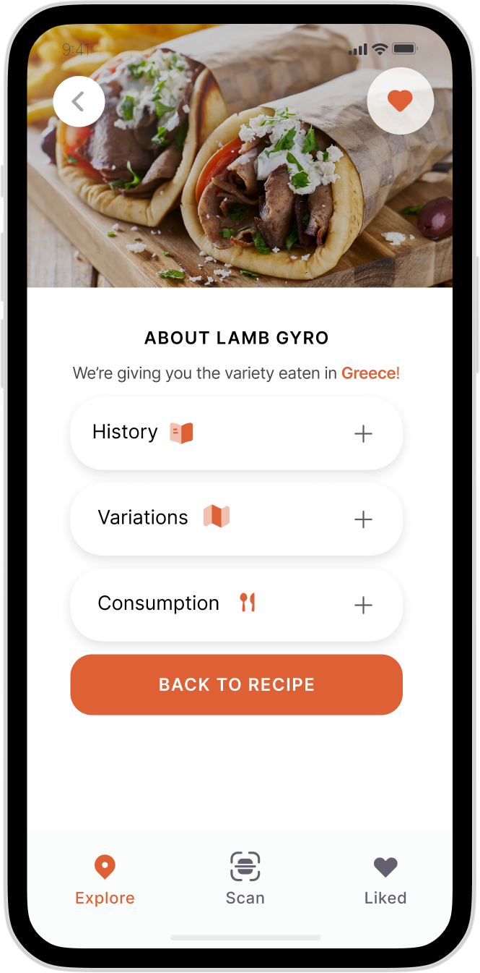
Before
Recipe context
After

Slide 67
Before
After
Unified format with ingredient context.
Easily switch back and forth between recipe
Block of text, less
readable

Slide 68
Our Current Focus
Frontend
Code up new recipe interface
Devise a way to highlight “national” dishes
Fix scanning API
Alter margins and spacing to adhere to Figma
Fixing password field
Backend
Complete data fetching
Populate with even more recipes (have ~30 as of now)

Slide 69
THANK YOU!

Slide 70
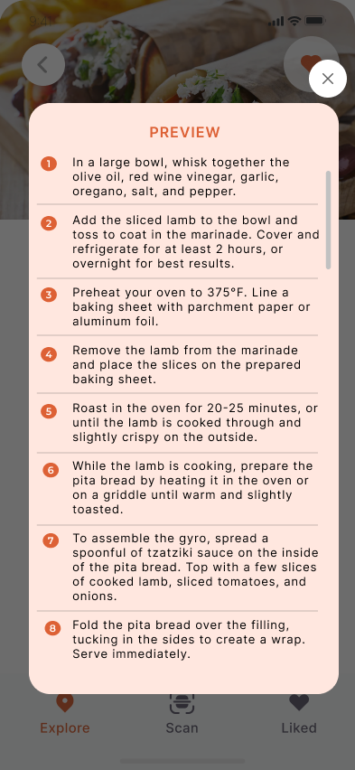
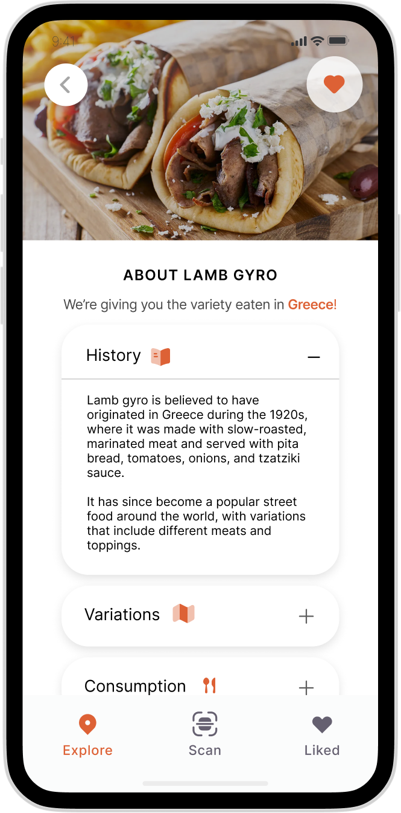
Appen-dish

Slide 71
Appen-dish
Participant notes
https://docs.google.com/document/d/1ARh323ypYJ2PTDgZY0s4VVFJ4H-Y0Eeh2biSjPwu_zA/edit
Pictures and videos
https://drive.google.com/drive/folders/11o99s44DUs4GtTLsslLvO9Ho3TqPVfG8?usp=share_link

Slide 72
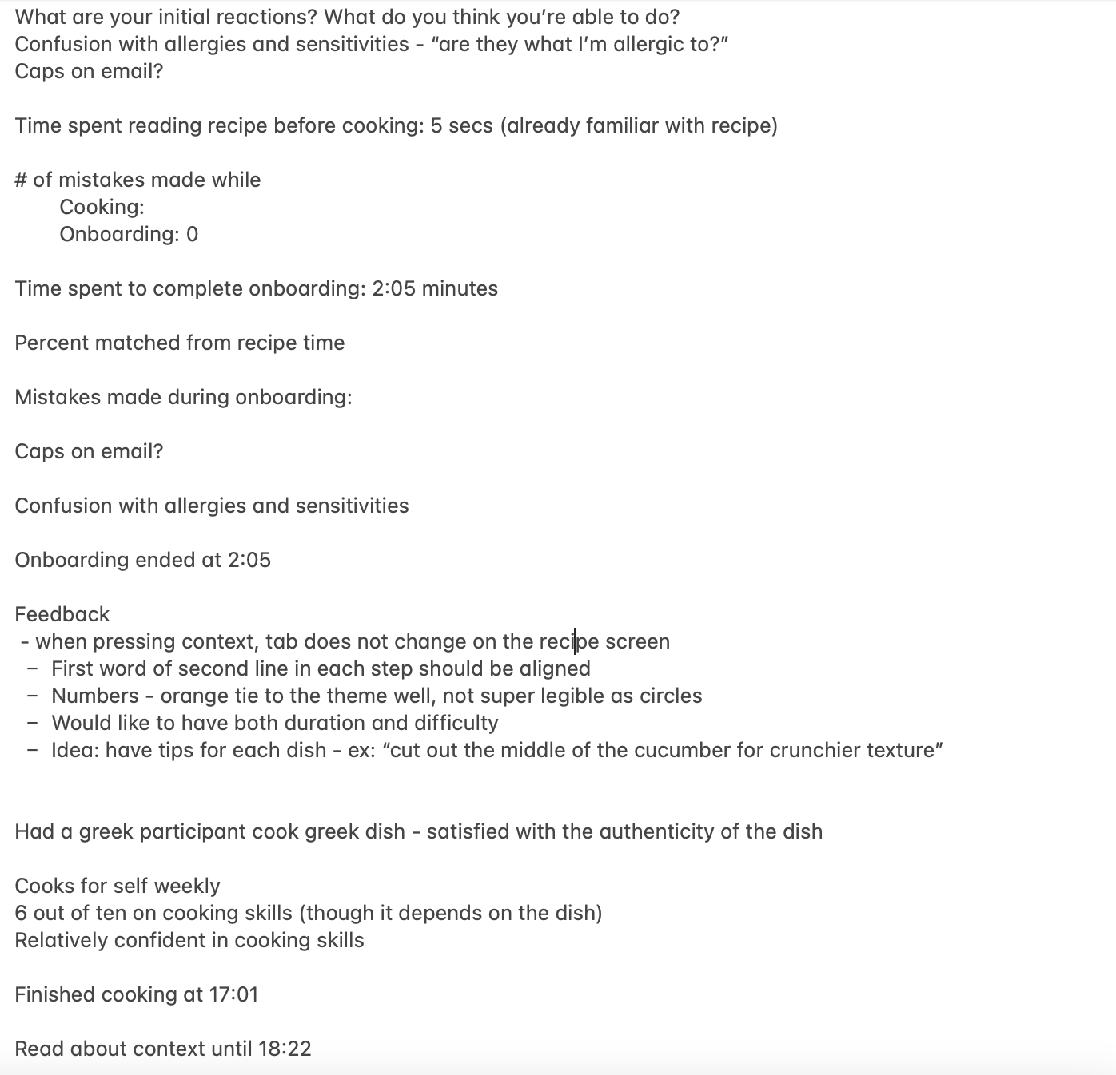
Appen-dish
Constantinos’s Notes

